Slide 1


Major Project : Demonstration –Phase 2 on
“IBALLOT : DECENTRALIZED VOTING SYSTEM USING BLOCKCHAIN”
GROUP NUMBER: MPG-02
Dept. of CS&E ( DATA SCIENCE)
Adichunchanagiri Institute of Technology
Chikkamagaluru - 577102
Presented By,
CHANDANA M (4AI22CD012)
DARSHITH C(4AI22CD015)
MADHURA N M (4AI22CD032)
RAO SIDDHARTH SHANKAR (4AI22CD042)
Under the Guidance of
Prof. SHALINI I S

Slide 2
ABSTRACT
iBallot is a decentralized voting platform that replaces vulnerable centralized servers with the Ethereum Blockchain. By integrating DigiLocker for identity verification, we enforce a strict "One Person, One Vote" rule while preserving voter anonymity. The result is a transparent, tamper-proof system that shifts reliance from human authorities to immutable code, ensuring every vote is counted exactly as cast.

Slide 3
CONTENTS
Introduction
Problem Definition
Objectives
Literature Survey
System Design
Software Requirements
Implementation Details
Result & Discussion
Conclusion & Future Enhancements
References

Slide 4
INTRODUCTION
Public trust in elections is declining due to the black-box nature of traditional EVMs and centralized systems.
Voters have no direct way to verify whether their vote is counted correctly.
iBallot addresses this by moving the voting process to the Ethereum blockchain.
Using DigiLocker-based authentication, it enables secure, remote, and verifiable voting.
The immutable blockchain ledger ensures transparency, auditability, and tamper resistance.

Slide 5
PROBLEM STATEMENT
Current electronic voting systems rely on centralized databases that act as a single point of failure. These systems are vulnerable to hacking, internal tampering, and lack a public audit trail, leading to growing skepticism regarding election outcomes.
To design and develop a decentralized voting system that eliminates the risk of data alteration by using blockchain technology, while simultaneously solving the issue of voter impersonation through government-verified identity authentication.

Slide 6
OBJECTIVES
To develop a decentralized application that prevents vote tampering using Ethereum Smart Contracts.
To implement a secure "Gasless" voting mechanism so voters don't need cryptocurrency to participate.
To integrate government-grade identity verification using DigiLocker APIs.
To provide a real-time, tamper-proof audit trail for election officials and voters.

Slide 7
Literature Survey
Title | Authors | Publications | Year | Outcome
DigiVote: Voting System Using Blockchain | Subhash Bahadur Thapa, Suraj B, Vijendran K, Vikash Khanna V | Technical Report (Project Report), Visvesvaraya Technological University | 2021 | Developed a tamper-proof web app using Ethereum and PHP for secure remote voting managed by the Election Commission
Title | Authors | Publications | Year | Outcome
DigiVoter: Blockchain Secured Digital Voting Platform with Aadhaar ID Verification | Navamani, T. M., et al. | ECS Transactions, The Electrochemical Society | 2022 | Integrated biometric Aadhaar verification with a Node.js blockchain to prevent double voting and ensure data immutability

Slide 8
Title | Authors | Year & Publications | Outcome | Concept Adopted? (✓)
Voting and Election System: using Blockchain Technology | Nandimath, A. & Mandape, S. | IJERT,2023. | Used DigiLocker credentials and webcam verification to store encrypted votes on private blockchain. | ✓ (DigiLocker API)
Title | Authors | Publications | Year | Outcome
Design and development of a decentralized voting system using blockchain | Md Ibrahim | International Journal of Communication and Information Technology (IJCIT) | 2023 | Created a decentralized Ethereum DApp that eliminates central servers to enhance transparency and data distribution

Slide 9
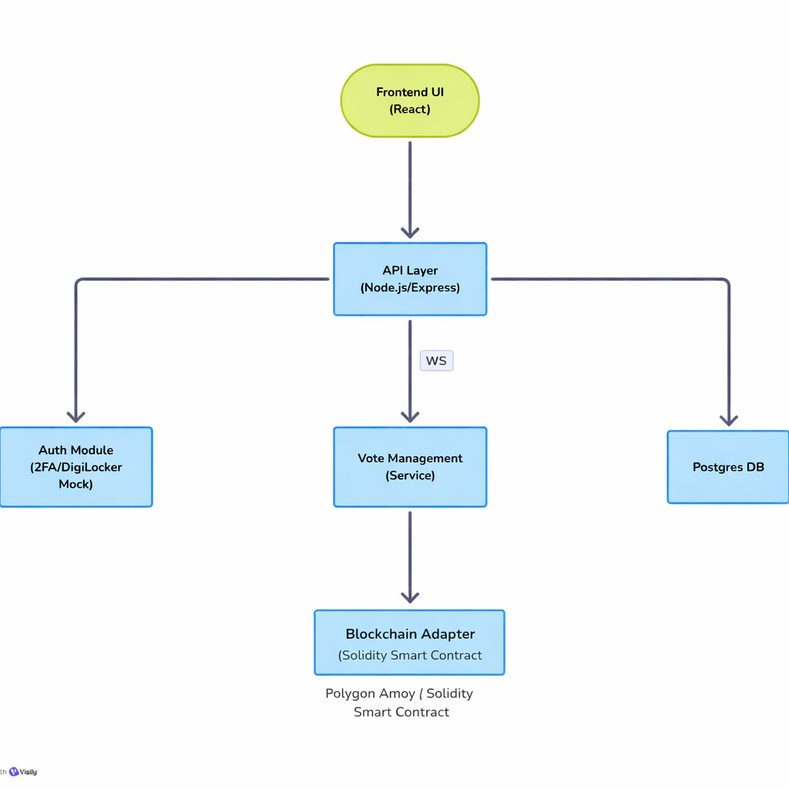
SYSTEM DESIGN

Slide 10
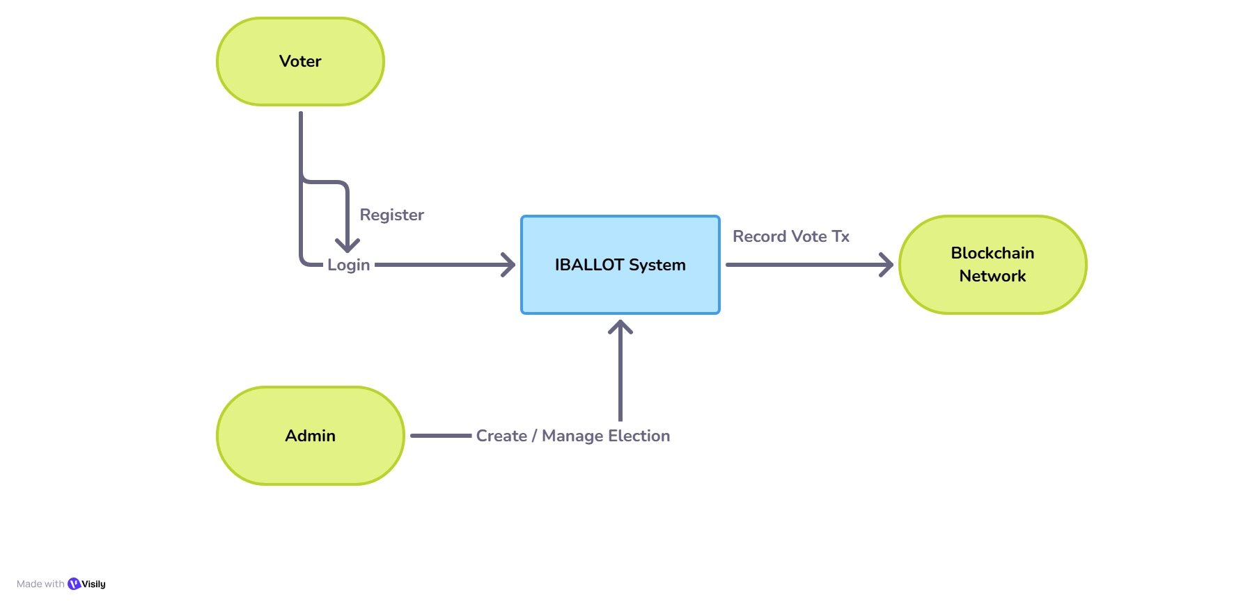
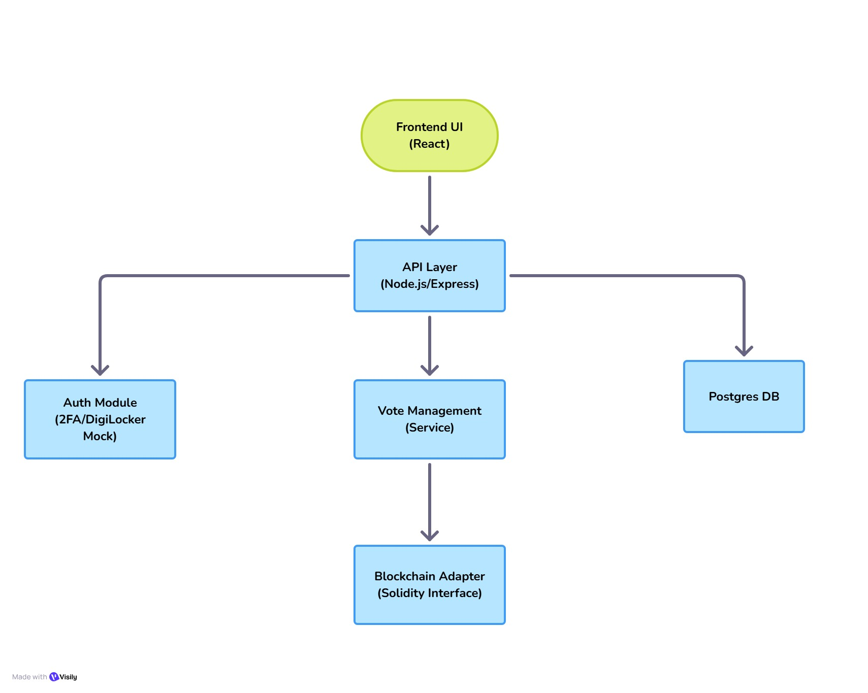
FLOW CHART
Fig-1:Interactions with IBALLOT system
Fig-2:Structural chart of system components and data flow

Slide 11
Software Requirements
Frontend Interface:
React.js + Vite
Tailwind CSS
Backend & Database:
Node.js & Express.js
Neon PostgreSQL (User Data)
Blockchain Technology:
Solidity (Smart Contract Logic)
Hardhat (Testing Framework)
MetaMask (Wallet Integration)

Slide 12
IMPLEMENTATION DETAILS
Module | Tech Stack | Key Logic
Smart Contract | Solidity | Anti-Double Vote: Uses mapping to reject repeat attempts. Immutable: vote() is write-only; no delete function. Secure: ReentrancyGuard prevents hack attacks.
Backend | Node.js & Ethers.js Express.js | Gasless: User signs off-chain; backend relays transaction. Robust: Auto-retries failed blockchain calls.
Identity Guard | Mock DigiLocker | Age Check: Enforces age >= 18 from verified DOB. Unique: Maps Aadhaar hash to Voter ID to ensure "One Person, One Vote".

Slide 13
Module | Tech Stack | Key Logic
Security Layer | AES-256 & Bcrypt SHA-256 | Key Safe: AES-encrypted private keys decrypted only to sign. Auth: Passwords hashed via bcrypt before storage.
Live Dashboard | React & WebSockets | Real-Time: ws:// connection pushes instant vote updates.
Hybrid DB | PostgreSQL | Optimized: Stores heavy data (photos) off-chain to save gas.

Slide 14
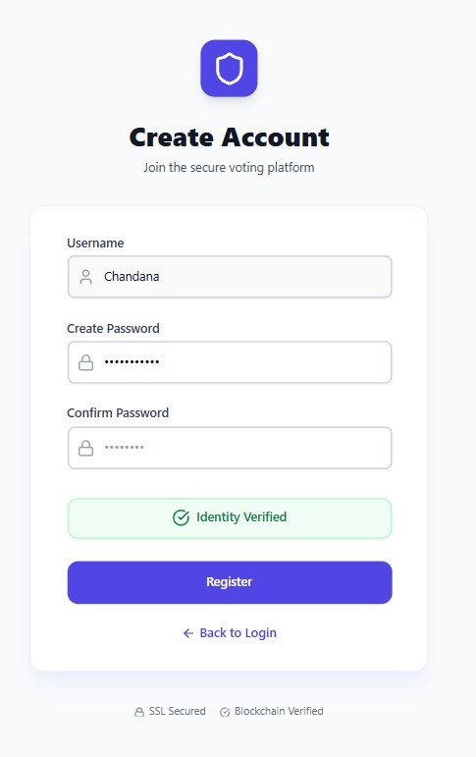
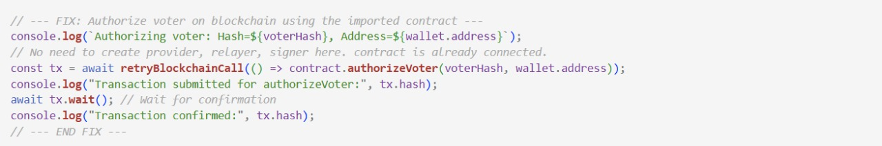
Results

Slide 15
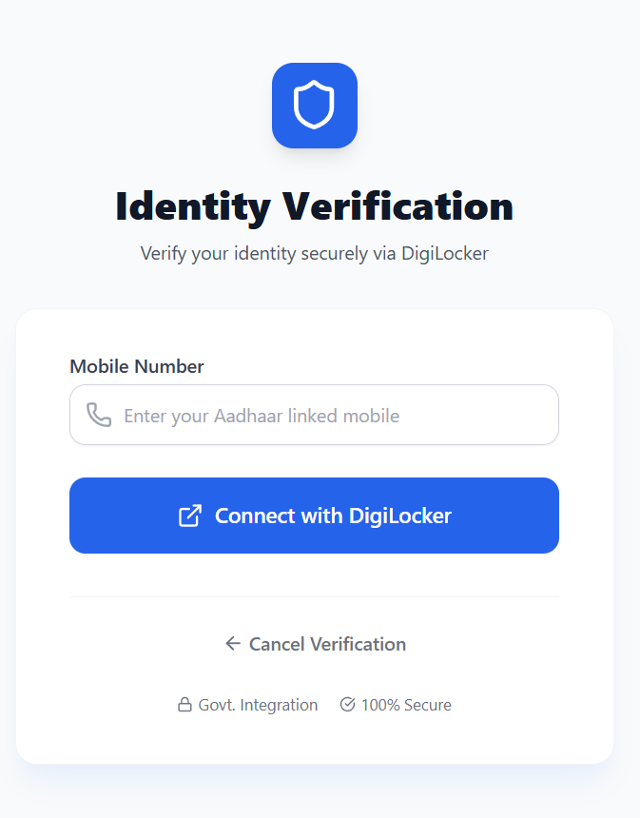
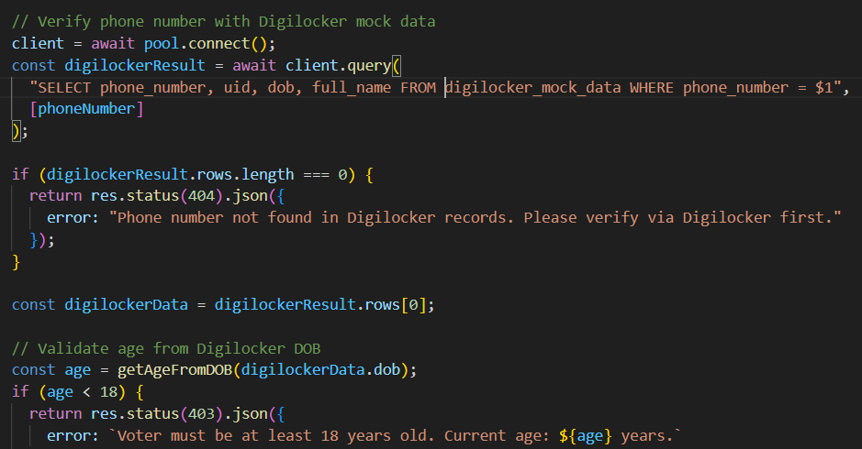
DIGILOKCER VERIFICATION

Slide 16
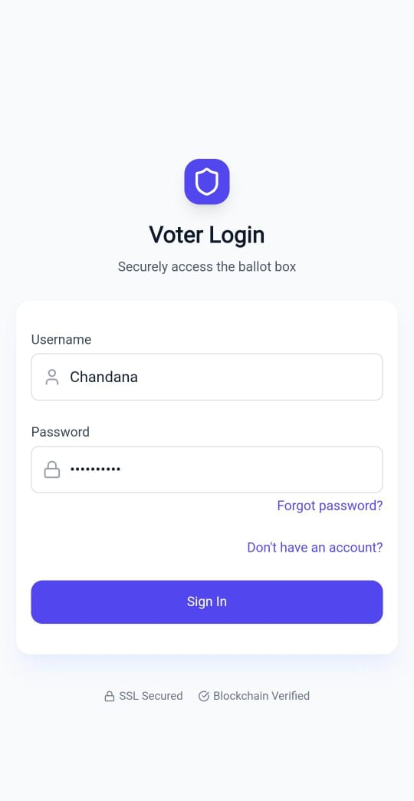
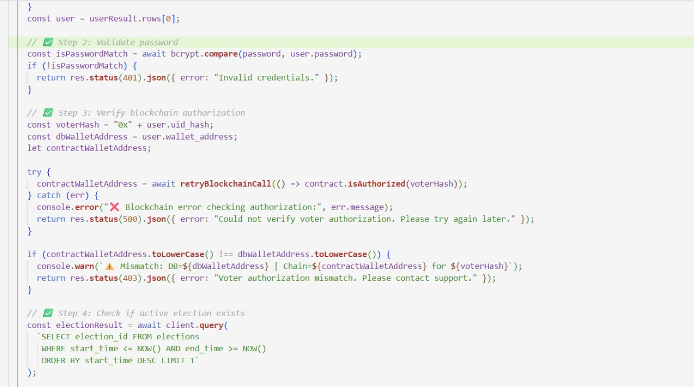
VOTER LOGIN

Slide 17
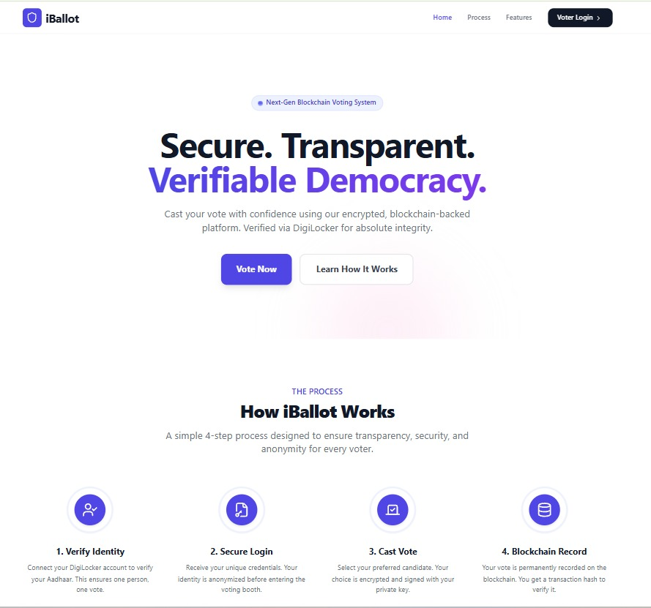
USER interface

Slide 18
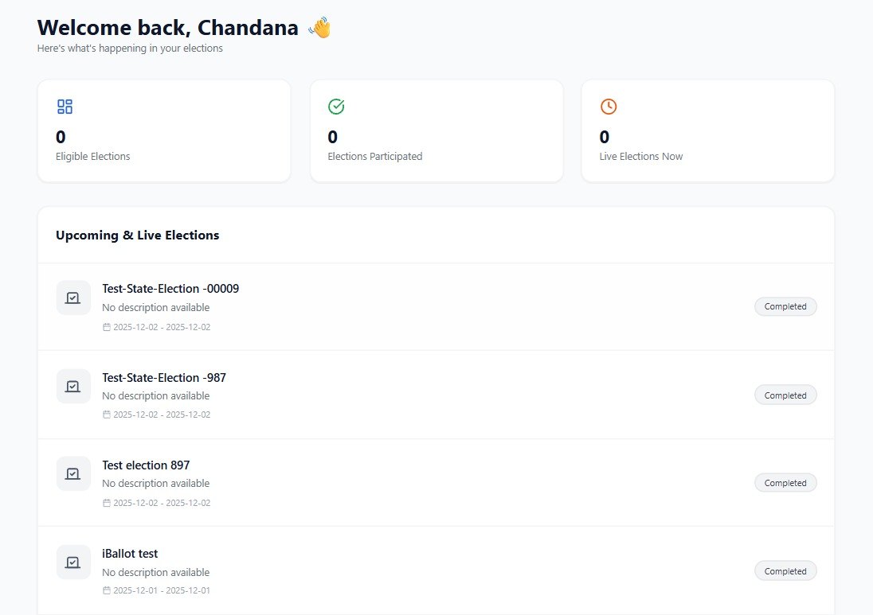
USER DASHBOARD

Slide 19
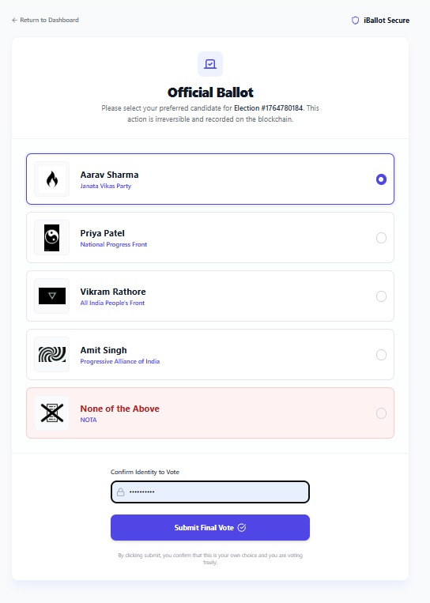
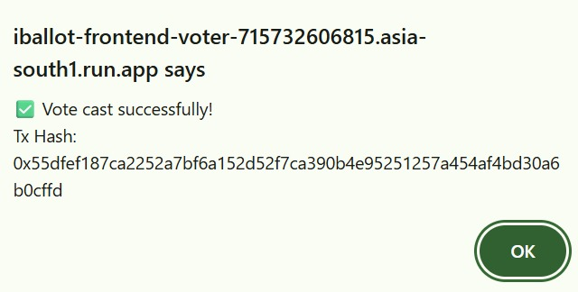
VOTE CASTING

Slide 20
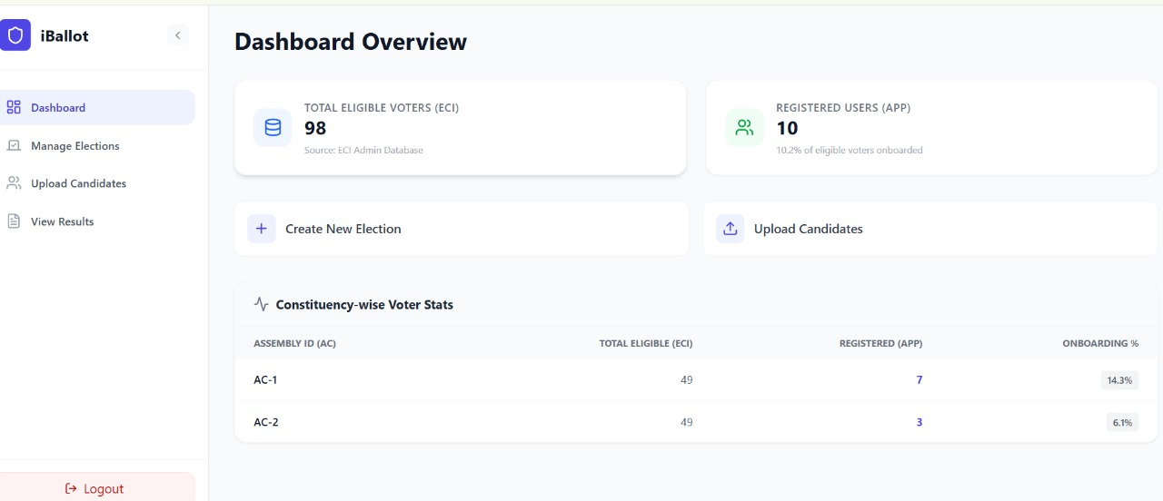
ADMIN DASHBOARD

Slide 21
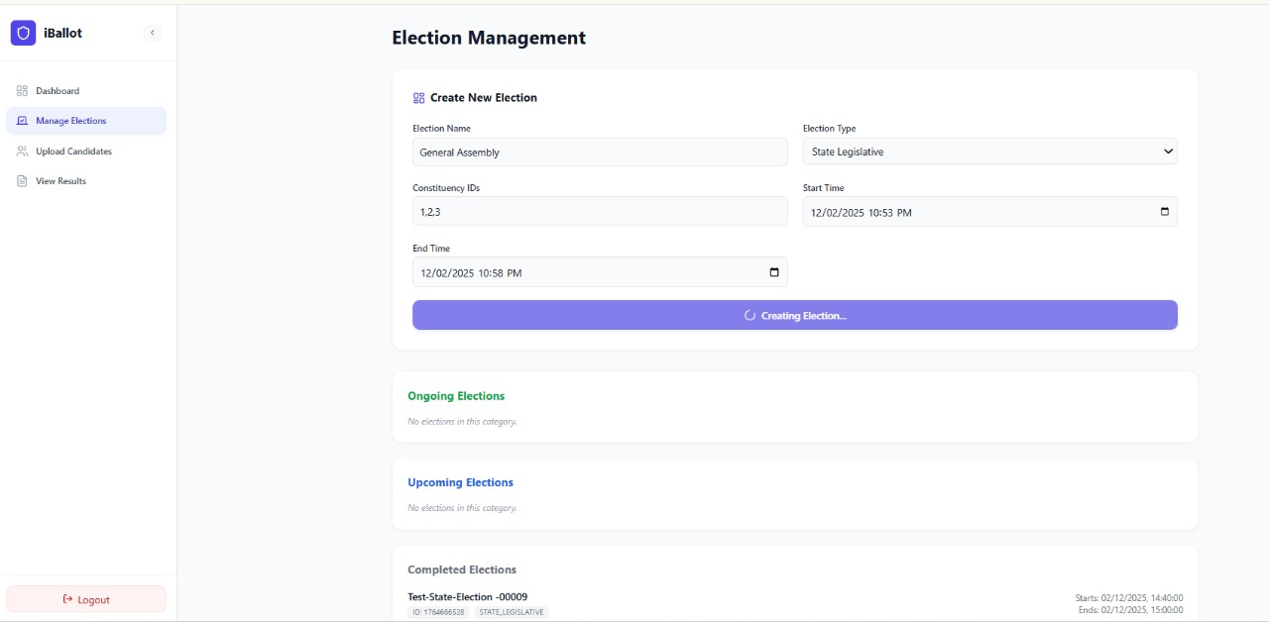
ELECTION MANAGEMENT

Slide 22
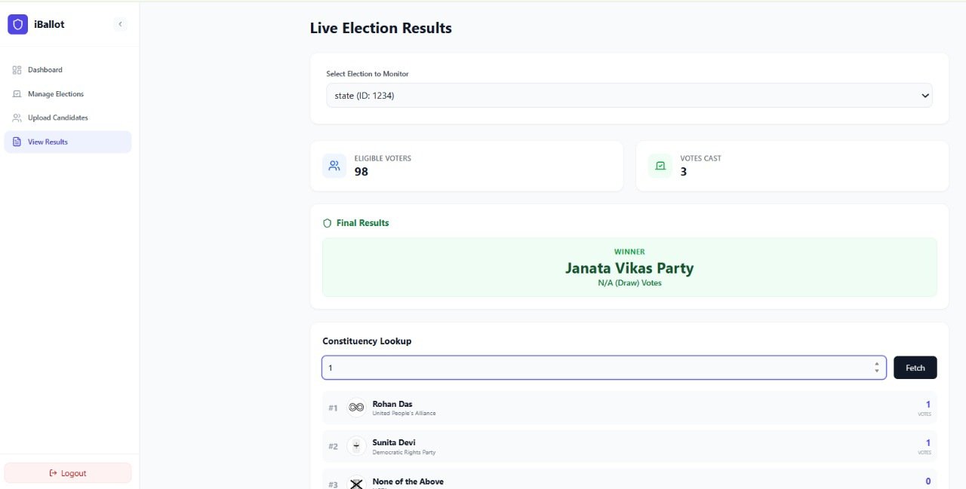
ELECTION RESULTS

Slide 23
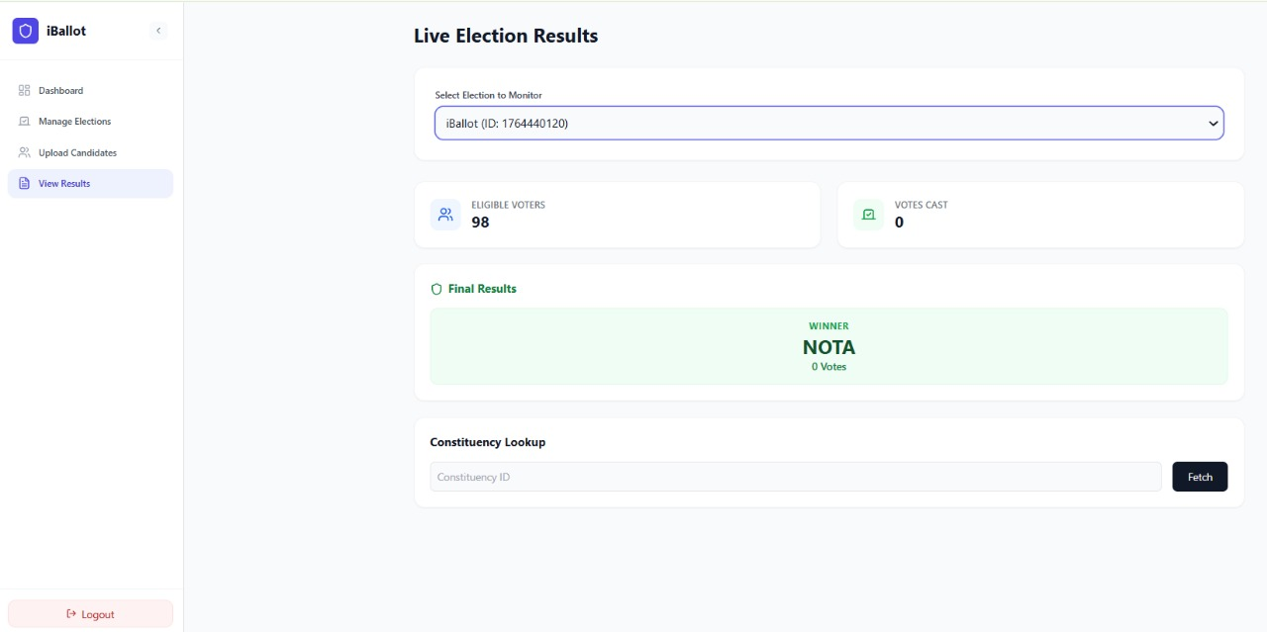
RESULTS

Slide 24
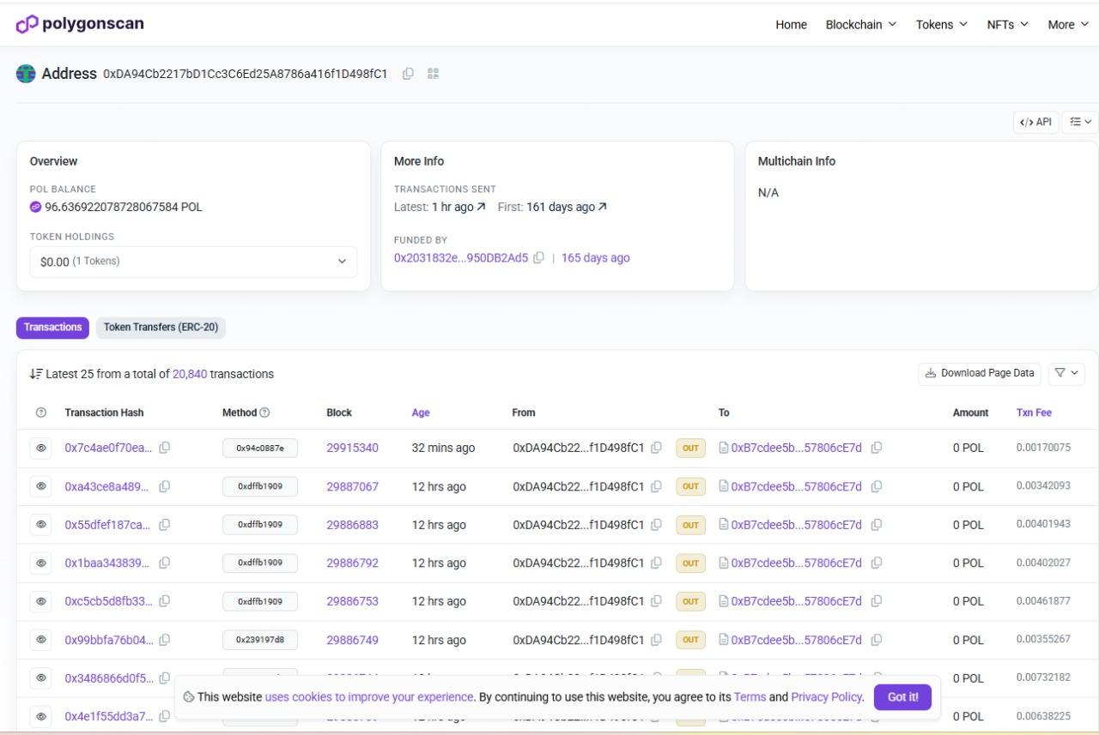
BLOCKCHAIN EXPLORER

Slide 25
Comparison (existing vs. proposed)
Parameter | Existing Systems (EVM ) | Proposed System (iBallot)
Architecture | Standalone Hardware: Isolated chips; physical access required for counting. | Decentralized: Distributed ledger; data exists across the entire network.
Data Integrity | Hardware Dependent: Vulnerable to chip replacement or physical tampering. | Immutable: Cryptographically sealed; mathematically impossible to alter history.
Transparency | "Black Box": Counting logic is hidden inside the machine's circuit. | Open Source: Smart Contract logic is public and verifiable by anyone.
Audit Trail | Paper VVPAT: Physical slips can be lost, damaged, or miscounted. | Digital: Instant, permanent Transaction Hash (0x...) for every vote.
Cost | High: Expensive manufacturing, storage, transport, and security. | Low: Software-based; uses "Gasless" Relayer for minimal fees.
Accessibility | Restricted: Voters must travel to specific physical booths. | Universal: Remote voting from anywhere via secure web portal.

Slide 26
Parameter | Existing Systems (Apps) | Proposed System (iBallot)
Trust Architecture | Centralized Server: Relies on a central authority (server admin) to host and count votes honestly. | Decentralized Ledger: Relies on Ethereum Smart Contracts; no single entity controls the counting logic.
Voter Identity | Admin-Managed: Uses email lists or simple passwords created by the election admin (prone to fake accounts). | Government-Verified: Integrates DigiLocker API to strictly authenticate legitimate Indian citizens via Aadhaar.
Data Storage | Private Database: Votes are stored on a cloud database which can be modified or deleted by a super-admin. | Immutable Blockchain: Votes are written to a public block; once mined, they are mathematically impossible to delete or alter.
Security Model | Encryption-Based: Uses complex cryptography to hide votes, but the server itself is a single point of failure (DDoS risk). | Distribution-Based: Data exists on thousands of nodes simultaneously, making the system resilient to server crashes or hacks.
Auditability | Complex Proofs: Verification requires understanding complex "Zero-Knowledge Proofs" or mix-nets. | Instant Hash: Any user can copy their unique Transaction Hash (0x...) and verify their vote on a public explorer immediately.

Slide 27
CONCLUSION
iBallot successfully redefines the electoral process by replacing traditional "blind trust" with cryptographic certainty. By integrating the Ethereum blockchain for immutable record-keeping and Mock DigiLocker for strict identity verification, we have built a system where every vote is verifiable, secure, and permanently tamper-proof. This project ultimately demonstrates that a decentralized approach can restore public confidence in democracy, shifting the paradigm from trusting central authorities to trusting transparent, unchangeable code.

Slide 28
FUTURE ENHANCEMENT
Deployment on Polygon Mainnet: Currently, the system runs on a test environment. Future development involves deploying the Smart Contracts on the Polygon Mainnet. This Layer-2 solution will drastically reduce gas fees to fractions of a cent and ensure the network can handle the throughput of a national-scale election.
Live DigiLocker API Integration: While the current prototype demonstrates the verification logic, the next phase involves integrating the Live Government DigiLocker API. This will enable real-time authentication of over 1 billion Indian citizens using their official Aadhaar and driving license data, replacing the current development mock environment.
Zero-Knowledge Proofs (ZKP) for Privacy We plan to implement zk-SNARKs to upgrade the system from pseudonymity to true anonymity. This advanced cryptographic method allows voters to mathematically prove they are eligible citizens without ever revealing their actual identity or Aadhaar number to the public blockchain, ensuring absolute voter secrecy.

Slide 29
References
T. M. Navamani, T. S. Sondhi, and S. Ghildiyal, “DigiVoter: Blockchain Secured Digital Voting Platform with Aadhaar ID Verification,” ECS Transactions, vol. 107, no. 1, pp. 7427–7440, Apr. 2022. DigiVoter: Blockchain Secured Digital Voting Platform with Aadhaar ID Verification - IOPscience
Md. Ibrahim, “Design and Development of a Decentralized Voting System Using Blockchain,” International Journal of Communication and Information Technology (IJCIT), vol. 4, no. 1, pp. 1–11, Jan. 2023. Design and development of a decentralized voting system using blockchain.
Nandimath and S. Mandape, “Voting and Election System: using Blockchain Technology,” International Journal of Engineering Research & Technology (IJERT), vol. 12, no. 4, Apr. 2023. voting-and-election-system-using-blockchain-technologyIJERTV12IS040084.pdf
S. B. Thapa, K. Vijendran, and V. K. V., “DigiVote: Voting System Using Blockchain,” Project Report, Dept. of CSE, AMC Engineering College, VTU, July 2021.
(PDF) DigiVote: Voting System Using Blockchain.

Slide 30
THANK YOU

